Slide 1

ECG Arrhythmia Classification
Building a trustworthy, explainable, and robust AI pipeline for cardiac rhythm analysis — where accuracy meets interpretability and resilience.
TRUSTWORTHY AI
XAI
ADVERSARIAL ROBUSTNESS

Slide 2

The Problem With "Good Enough" Accuracy
🎯 Accuracy Isn't Everything
🔒 Black-Box Models
Clinicians cannot trust or act on decisions they cannot understand or verify.
High accuracy on benchmarks masks critical failure modes in real clinical settings.
⚡ Adversarial Vulnerability
Subtle signal perturbations can silently fool even high-performing models.

Slide 3
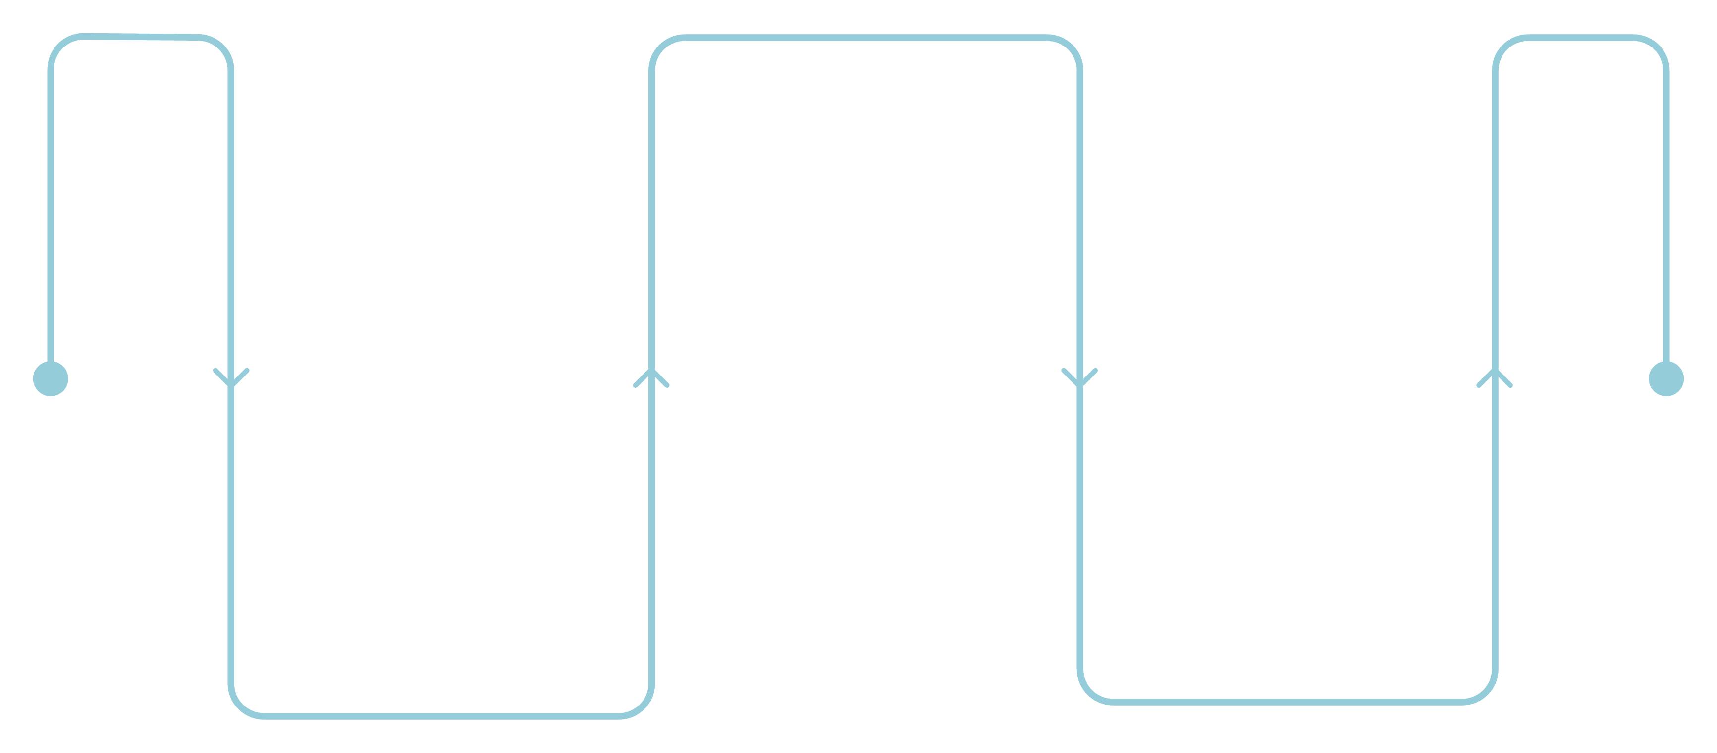
Our Solution: An End-to-End Trustworthy Pipeline
Explainable AI
Grad-CAM and Integrated Gradients
Adversarial Robustness
End-to-End ECG
Raw signal to classification
FGSM, PGD, adversarial training
Each stage is designed to address a distinct gap in conventional ECG deep learning systems — moving beyond prediction into transparency and resilience.

Slide 4





System Pipeline
Raw ECG
12-lead or single-lead signal acquisition
Preprocessing
Noise removal, normalisation, baseline correction
Segmentation
Beat detection and windowing into fixed-length segments
Model
CNN / ResNet / Hybrid classification
XAI + Robustness
Explanation generation and adversarial evaluation

Slide 5
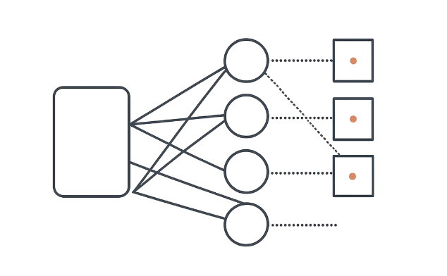
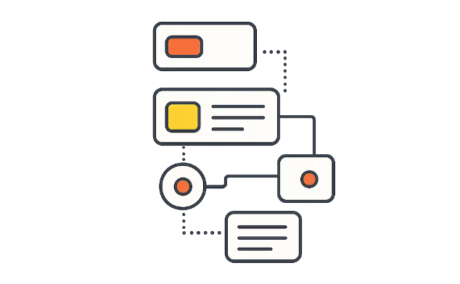
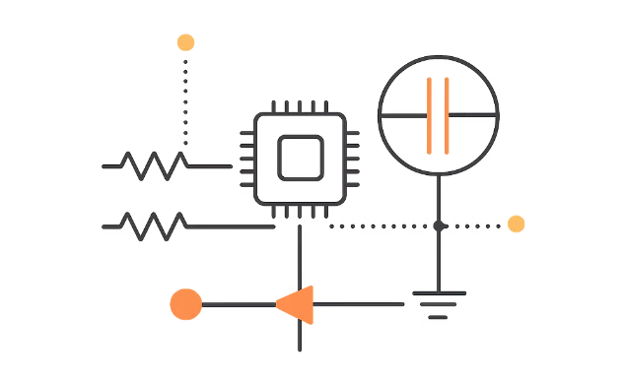
Model Strategy
CNN
ResNet
Hybrid
Most stable architecture. Lightweight, fast to train, and consistently reliable. The strongest baseline for adversarial evaluation.
Richer feature extraction via residual connections. Captures deeper signal patterns but shows moderate robustness degradation.
Combines CNN + recurrent elements for temporal modelling. Most expressive — but also most sensitive to perturbations.

Slide 6
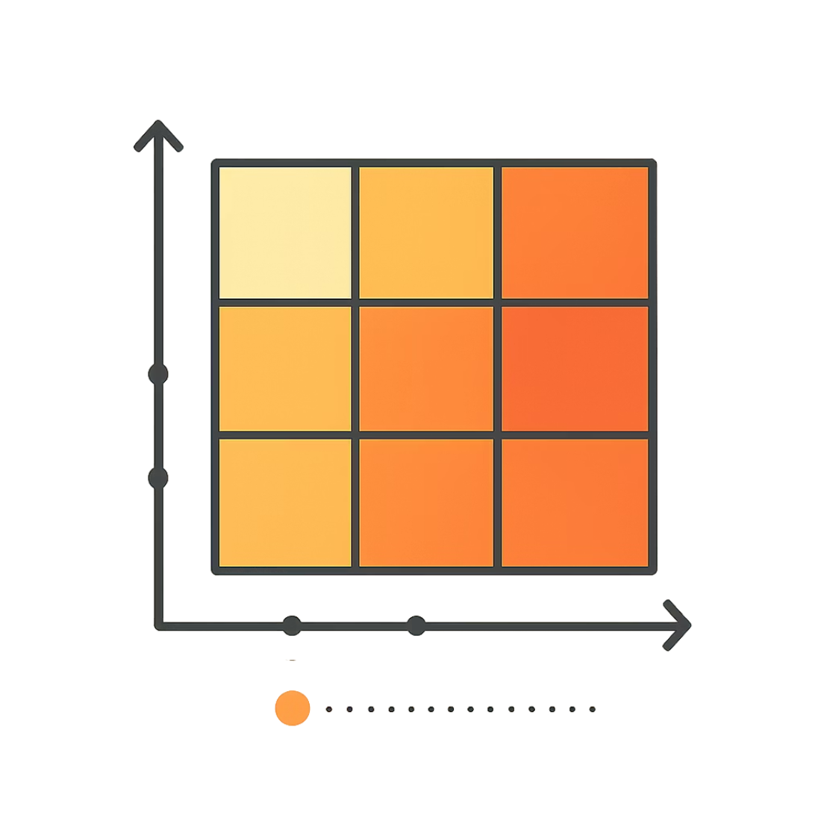
Explainable AI
Transparency is not optional in clinical AI. We integrate two complementary XAI methods to surface what the model is attending to — and verify that explanations remain stable under pressure.
Grad-CAM — highlights temporal regions of the ECG signal driving each classification decision
Integrated Gradients — attributes prediction confidence to individual input features
Explanation Stability evaluation — tests whether explanations hold under input noise and adversarial conditions

Slide 7

Adversarial Robustness
FGSM Attack
Fast Gradient Sign Method — single-step perturbation to rapidly stress-test model boundaries with minimal noise.
PGD Attack
Projected Gradient Descent — iterative, stronger adversarial pressure that reveals deeper model vulnerabilities.
Adversarial Training
Models are retrained on adversarial examples to build inherent resilience into the weights themselves.

Slide 8
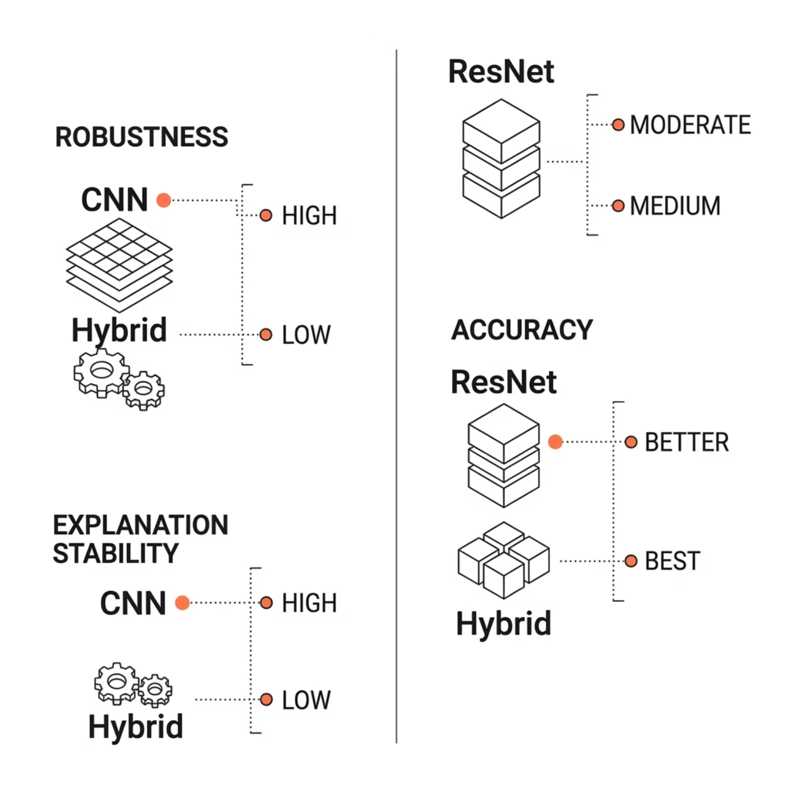


Results at a Glance
Key Findings
CNN — most robust to adversarial attacks; stable, reliable explanations
ResNet — moderate accuracy gains with moderate robustness drop
Hybrid — highest raw accuracy but greatest degradation under attack
Complexity is a double-edged sword — the most expressive models are the most fragile.

Slide 9



The Core Insight
1
Interpretability
2
Robustness
3
Accuracy
No single model excels at all three. Robust models produce more stable explanations, while complex models trade resilience for performance. Designing trustworthy AI means navigating this triangle deliberately — not accidentally.

Slide 10





Contribution & Impact
Trustworthy AI Framework
XAI + Adversarial Integration
A reusable, modular pipeline unifying accuracy, explainability, and robustness for ECG classification tasks.
First-class integration of Grad-CAM, Integrated Gradients, and adversarial evaluation within one coherent system.
Model Trade-Off Insights
Empirical evidence that guides practitioners in selecting models aligned with their clinical risk tolerance.

